Slide 1

TESTING COE
SUJITH REDDY
SENIOR QA Engineer
Ph- 9480860587
LinkedIn - https://www.linkedin.com/in/sujith-reddy-173a9381/

Slide 2
Automation Testing Skills:
Proficiency in Creating Hybrid Automation Framework using C# and Java from Scratch.
Possess excellent skills in Manual Testing and Automation Testing using C# and Java.
Excellent understanding of creating Test Data, Test Cases and knowledge of Use Cases and experience in execution of Test Cases.
Experience in Tracking Defects and well versed with BUG life Cycle using Azure Devops.
Conducted Smoke Testing, System testing, Regression testing and Ad-hoc testing, UAT.
Experience in preparing various Test Specifications like Test Scenarios, Test Cases, Test Data, Defect Reports, and Test Reports etc.

Slide 3
Technical Skills
Manual Testing Skills: Black Box, Functional, Non-Functional, Ad-Hoc, Sanity/Smoke, Regression, System, Integration, Installation, Cross Browser, Compatibility Testing, cloud-based testing
Automation Frameworks : BDD Framework ,Hybrid Framework
Automation Testing Skills: Well versed with agile, DevOps and continuous delivery.
Bug Tracking Tools: Mantis Hub, Microsoft Azure Devops
Test Management Tools: Microsoft VSTS, Test Flight, App center.
Repository: Git, TFS.
Automation Skills : API Automation using Java, UI automation Using C#
Tools: Selenium web Driver, Visual Studio, InteliJ IDEA.

Slide 4
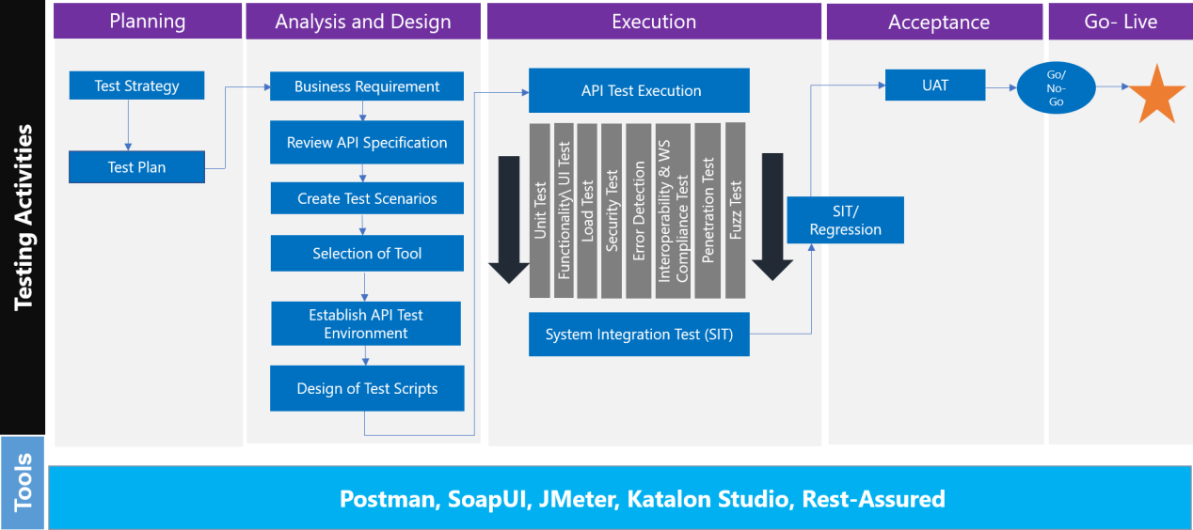
Automation Testing Process
API Testing: The process involves detailed analysis of the APIs used, test data generation, simulating the API flow and versioning

Slide 5
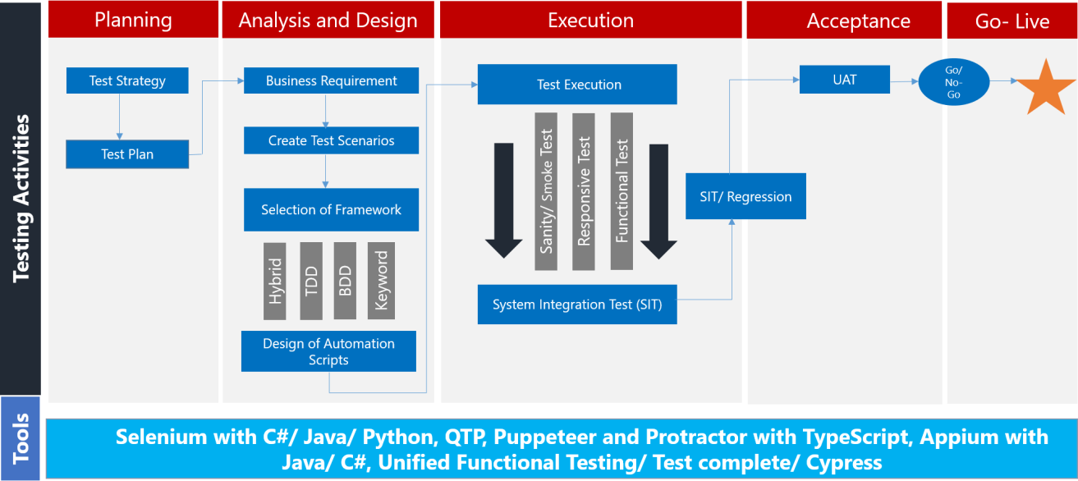
Application / UI Testing: This involves choosing the right tools, analyzing the business requirements in detail, analyzing the various bowsers supported.

Slide 6
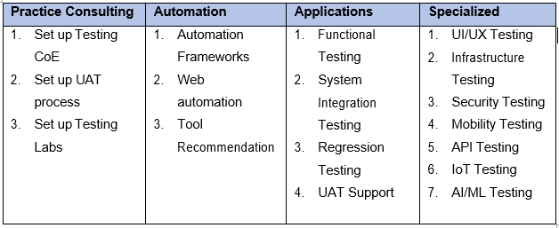
Testing Practice Overview
I provide testing and QA services across different functional areas of software development as below

Slide 7
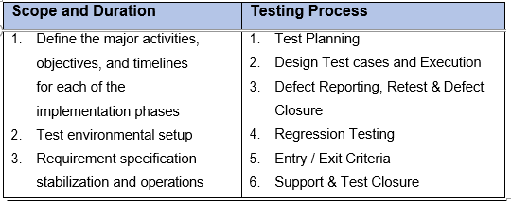
Set-up

Slide 8
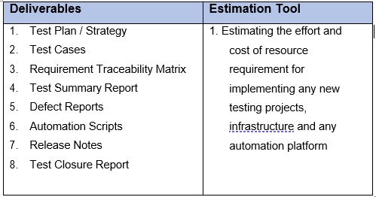
Execution and Maintenance

Slide 9
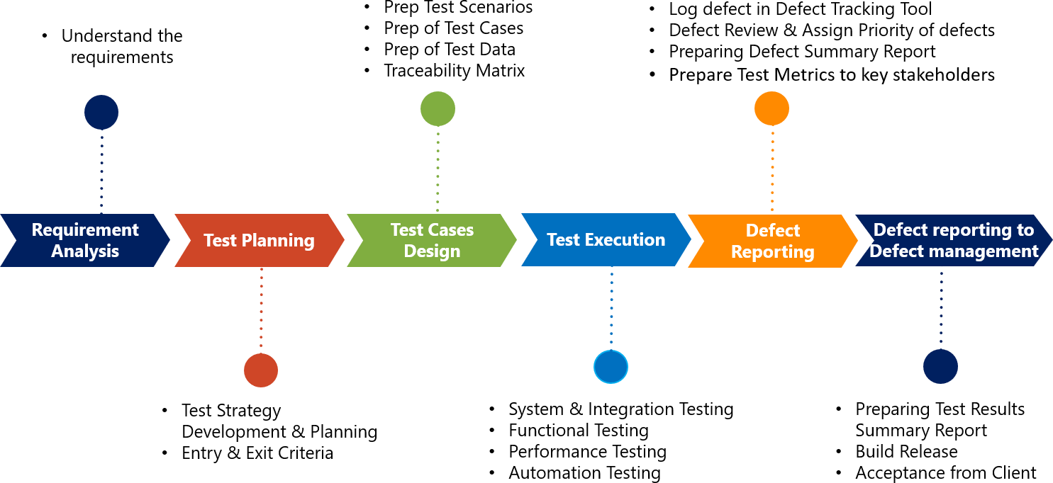
I follow a proven and successful methodology across all projects to ensure high quality deliverables.

Slide 10
THANK YOU

